Slide 1
x
f(0,0) | f(1,0) | f(2,0) | f(3,0) | f(4,0)
f(0,1) | f(1,1) | f(2,1) | f(3,1) | f(4,1)
f(0,2) | f(1,2) | f(2,2) | f(3,2) | f(4,2)
f(0,3) | f(1,3) | f(2,3) | f(3,3) | f(4,3)
f(0,4) | f(1,4) | f(2,4) | f(3,4) | f(4,4)
y

Slide 2
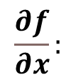
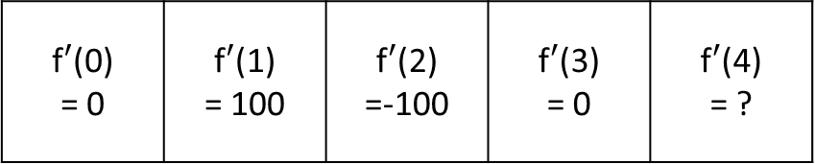

x
f(0) = 100 | f(1) = 100 | f(2) =200 | f(3) = 100 | f(4) = 100
$$f(x):$$
x
f$′$(0) = 0 | f$′$(1) = 100 | f$′$(2) =-100 | f$′$(3) = 0 | f$′$(4) = ?
$$\frac{∂f}{∂x}:$$

Slide 3
Bild Mux
D
Q
D
Q
&
+
S
Q
>
R
Q
>

Slide 4
Ist Zustand Perske
camera tapping base
CAM Data Mux
SDRAM Write Buffer
Memory Access Control
SDRAM Controler
CAM
SDRAM Read Buffer
SDRAM Pixel Buffer
Debay
Laplace Filter
VGA

Slide 6
Neuer Zustand
camera tapping base
CAM Data Mux
SDRAM Write Buffer
Memory Access Control
SDRAM Controler
CAM
SDRAM Read Buffer
SDRAM Pixel Buffer
Debay
Laplace Filter
DEB_OBJ_
DETECTION
VGA
x, y
or
OBJ_
DETECTION
DETECTION ALGORITHMS
x
LINE_ DETECTION
LINE_ DETECTION_CONV
NEU

Slide 7
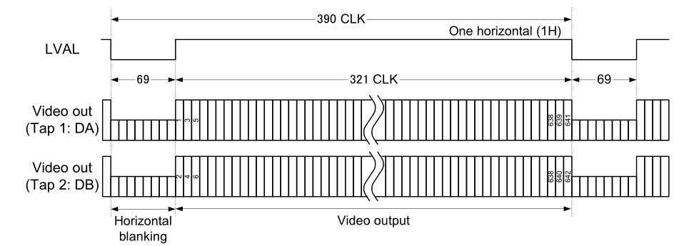
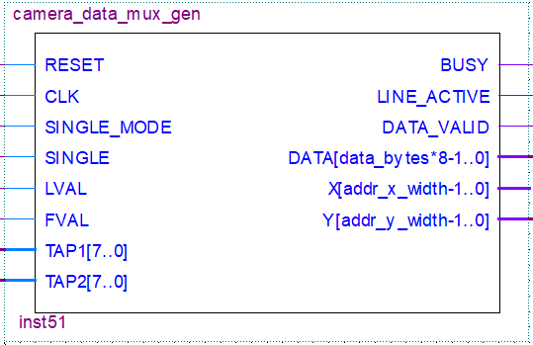

Slide 8
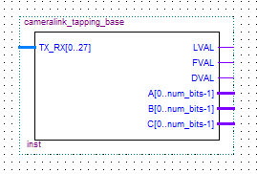
Camera Link Daten 28-bit
Steuersignale
TAP2
TAP3

Slide 9
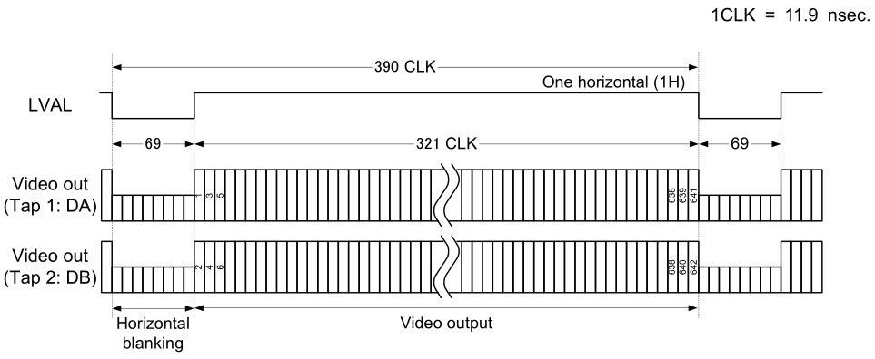

Slide 10
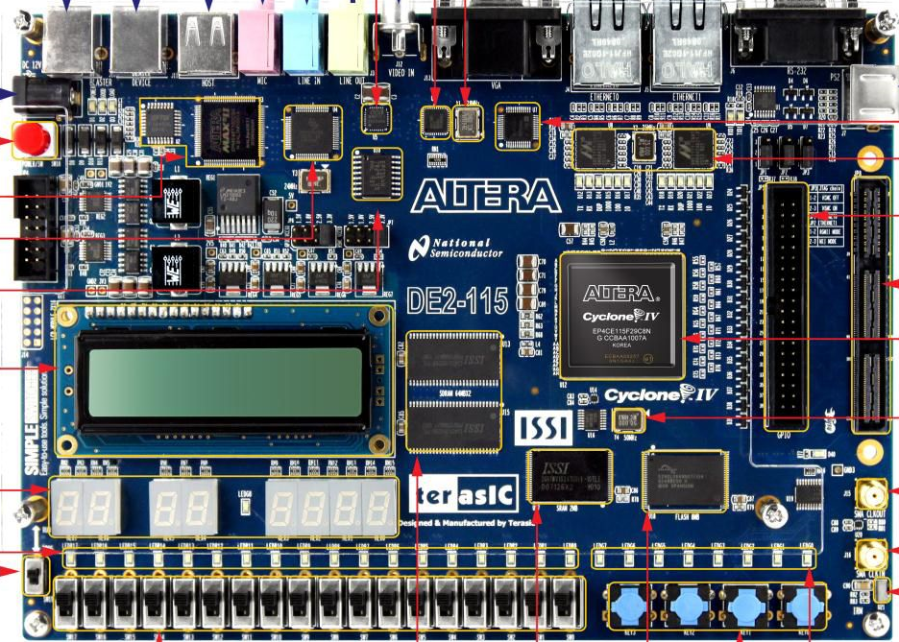
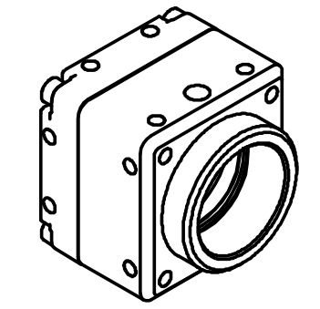
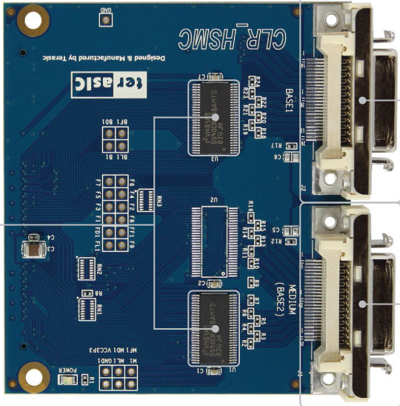
VGA
Camera Link
Kamera
Sentech
STC-CMC33PCL

Slide 11
Pixel_Buffer
1
2
3
buf_data
4
5x5 8bit Shift Reg
Debay
5
Linie 4 A
Linie 3 A
Linie 2 A
Linie 1 A
Linie 4 B
Linie 3 B
Linie 2 B
Linie 1 B
Buffer A or B
4x8 FiFo A
4x8 FiFo B

Slide 12
camera_data_mux_gen
TAP2 (8 Bit)
D
Q
>
TAP1 (8 Bit)
D
Q
>
4 x 8 Bit Shift Register
Shift by 2 Byte
SDRAM_Write_Buffer_gen
CLK
DATA (32 Bit)

Slide 13
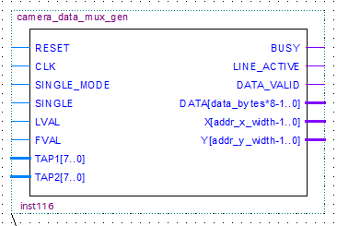

Slide 14
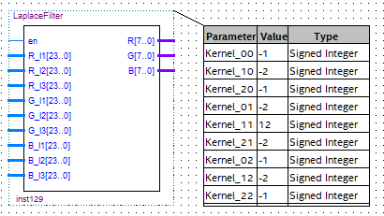
Filterkernparameter
Kernel 00 | Kernel 01 | Kernel 02
Kernel 10 | Kernel 11 | Kernel 12
Kernel 20 | Kernel 21 | Kernel 22

Slide 15
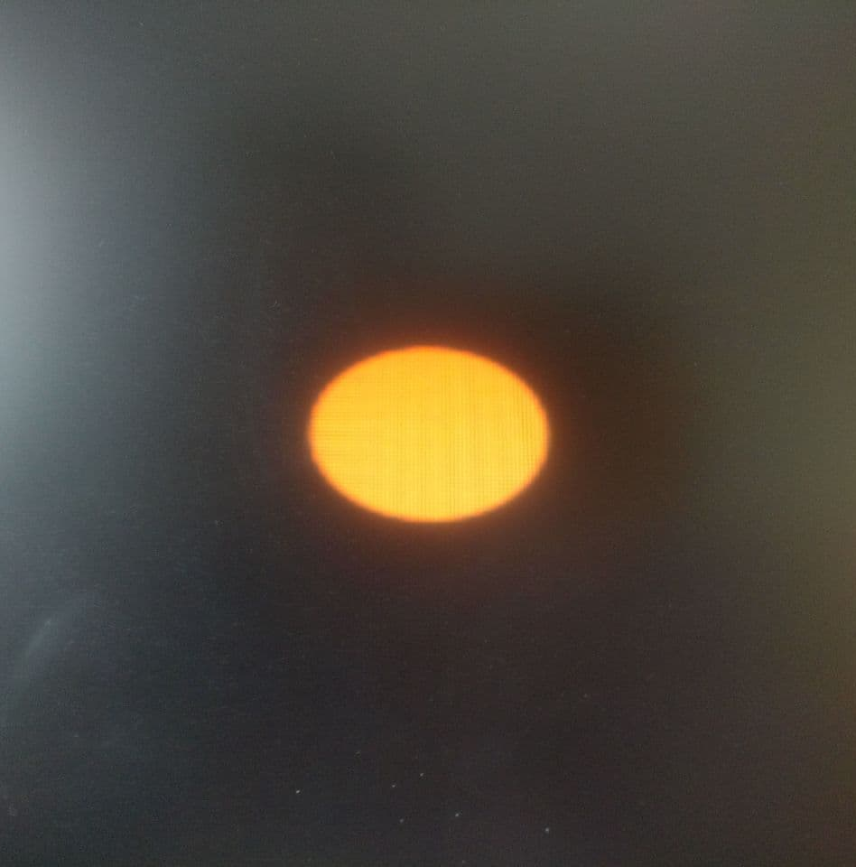


Slide 16

a | b | c
d | e | f
g | h | i
-1 | -2 | -1
-2 | 12 | -2
-1 | -2 | -1
-a | -2*b | -c
-2*d | 12*e | -2*f
-g | -2*h | -i
R Kanal, 3x3 Byte
Filterkernparameter
R Kanal + Gewichtung
-a | -2*b | -c
-2*d | 12*e | -2*f
-g | -2*h | -i
Rl1
Ø
R[7..0]
Rl2
$$\frac{(−a−2b−c−2d+12e−2f−g−2h−ⅈ)}{9}$$
Rl3
R Kanal + Gewichtung

Slide 17
a | b | c
d | e | f
g | h | i
0 | 0 | 0
0 | 1 | 0
0 | 0 | 0
e
R[7..0]
R Kanal, 3x3 Byte
Filterkernparameter

Slide 18
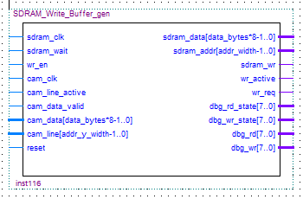
CLOCK Signale -SDRAM
-Kamera

Slide 19
SDRAM_Write_Buffer_gen
cam_data
cam_clk
D
Q
+
sdram_addr
>
+2 Byte
FIFO
FIFO gefüllt
wr_req
camera_ data_ mux_gen
Memory Access Control
D
Q
sdram_data
sdram_clk
>
sdram_wait
wr_en
&
wr_active

Slide 20
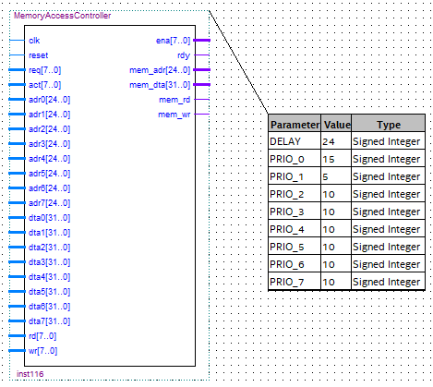
req
act
ena
rdy

Slide 21
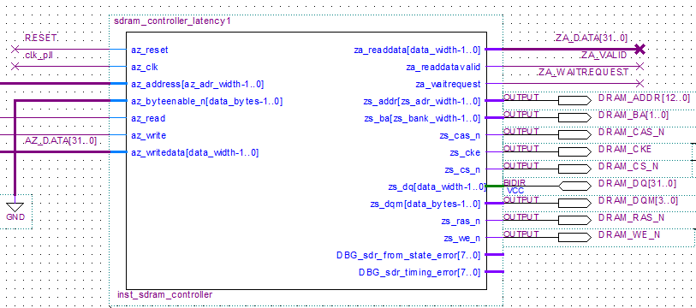
Hardwarezugriff

Slide 22
sdram_controller_latency1

Slide 23
FIFO A
FIFO B
SDRAM data
VGA data
Internes Signal:Buffer A or B

Slide 24
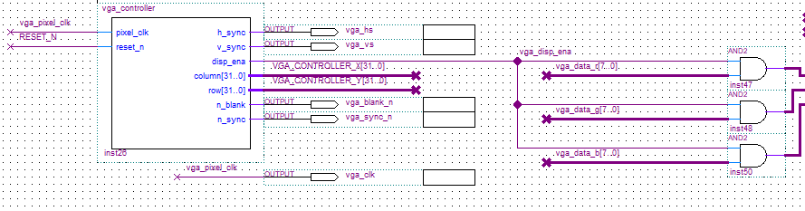
Steuerung VGA Protokoll
RGB Kanäle für VGA Ausgabe

Slide 25
x
Extrahierte Information:
Start
Ende
f(0,0) | f(1,0) | f(2,0) | f(3,0) | f(4,0)
f(0,1) | f(1,1) | f(2,1) | f(3,1) | f(4,1)
f(0,2) | f(1,2) | f(2,2) | f(3,2) | f(4,2)
f(0,3) | f(1,3) | f(2,3) | f(3,3) | f(4,3)
f(0,4) | f(1,4) | f(2,4) | f(3,4) | f(4,4)
- | -
f(1,1) | f(3,1)
f(1,2) | f(3,3)
f(1,3) | f(3,3)
- | -
y

Slide 26
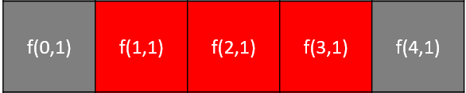


x
$$f(x):$$
$$\frac{∂f}{∂x}:$$
+ THRESHOLD
Rotkanal
- THRESHOLD

Slide 27
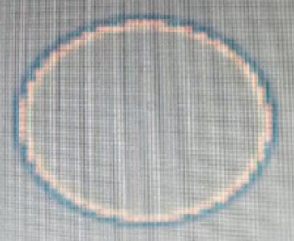
Kante 1
Kante 2
Kante 1
Kante 2
Rotkanal Laplace-gefiltert
+ THRESHOLD
x

Slide 28
x
Extrahierte Information:
Start
Ende
f(0,0) | f(1,0) | f(2,0) | f(3,0) | f(4,0)
f(0,1) | f(1,1) | f(2,1) | f(3,1) | f(4,1)
f(0,2) | f(1,2) | f(2,2) | f(3,2) | f(4,2)
f(0,3) | f(1,3) | f(2,3) | f(3,3) | f(4,3)
f(0,4) | f(1,4) | f(2,4) | f(3,4) | f(4,4)
- | -
f(1,1) | f(3,1)
f(1,2) | f(3,3)
f(1,3) | f(3,3)
- | -
Höhe Objekt 3 Zeilen
y

Slide 29
LINE_DETECTION
set detect_end_of _line_state
R
clk
D
Q
D
Q
>
>
detect_start_of_line_state
&
1.Ableitung Gonsalez
a
Vergleich
a-b
a
a>b
b
a<b
set rest_state
b
a=b
det_obj_found
threshhold
&
detect_end_of_line_state
pxl_pos_x
det_obj_x_pos_beg
D
Q
D
Q
>
>
&
set detect_start_of _line_state
det_obj_x_pos_end
„0“
D
Q
>
detect_start_of_line_state
detect_end_of_line_state
rest_state
detection_state_machine:

Slide 30
LINE_DETECTION_CONV
set detect_end_of _line_state
R
clk
D
Q
D
Q
>
>
detect_start_of_line_state
&
Vergleich
a
a>b
a<b
set rest_state
b
a=b
det_obj_found
threshhold
&
detect_end_of_line_state
pxl_pos_x
det_obj_x_pos_beg
D
Q
D
Q
>
>
&
set detect_start_of _line_state
det_obj_x_pos_end
„0“
D
Q
>
detect_start_of_line_state
detect_end_of_line_state
rest_state
detection_state_machine:

Slide 31
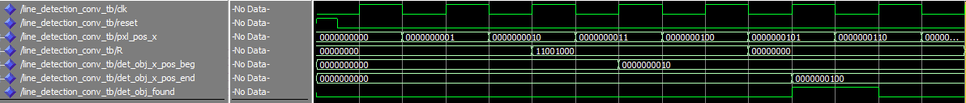
Signale
R=0
R=200
R=0
Ausgangssignale
Objekt erkannt

Slide 32
OBJECT_DETECTION
clk
det_obj_x_pos_beg
out = x + (x+y)/2
D
Q
signal:
last_det_obj_x_pos_beg
x
out
D
Q
obj_center_x
y
>
>
det_obj_y_pos_beg
D
Q
signal:
last_det_obj_y_pos_beg
D
Q
obj_center_y
>
>
1
det_obj_found
&
D
Q
signal:
line_count = line_count + 1
>
cur_pos_x
Vergleich
cur_pos_y
&
D
Q
signal:
line_count = 0
signal: line_count
a
a>b a<b
a=b
>
30
b

Slide 33
DEBUG_OBJECT_DETECTION
R
0
R_out
G
G_out
255
B
B_out
0
pxl_center_x
pxl_center_y
&
>1
&
det_obj_x_pos
det_obj_y_pos
&
enable

Slide 34
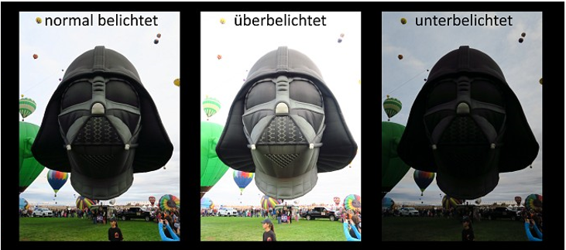
https://www.flocutus.de/besser-fotografieren-belichtungbetter-photography-exposure/
https://www.flocutus.de/wordpress/wp-content/uploads/pseudohdr_vader-1.jpg

Slide 35
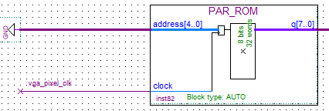
wasd
threshold
LINE_ DETECTION_
CONV

Slide 36
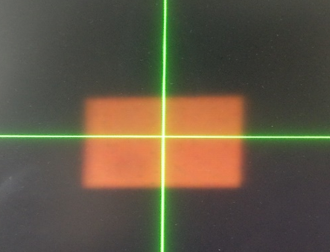
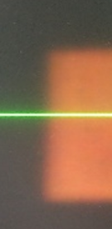

Slide 37

255
Rotkanal
0
4
8
12
16
20
24
28
32
36
40
44
Pixel

Slide 38


